Slide 1
NYC Evictions From
2017 - Current
Identify data trends to support potential policy recommendations
Muhammad Ahmad, Sadia Yesmin, Shuvam Bhowmick, Isabel Vazquez, Victoria Huang

Slide 2
Our Mission
To identify data trends for the NYC Housing Authority using a data set that lists pending, scheduled, and executed evictions within the five boroughs. Using this data analysis to support potential policy recommendations.

Slide 3
Points of Discussion
What is an Eviction?
2020 NYC Eviction Breakdown by Borough
Eviction vs Possession
Timeline/Contributing Factors: COVID-19 Pandemic
Recommended Policy changes
Notes:
https://docs.google.com/presentation/d/1GonYwgCKV6FQqI_gFNljTumVEeX0u346/edit#slide=id.p3
Policy changes need more information for proof of Policy changes ie. people keeping their house leeds to better outcome.

Slide 4
What is an Eviction?

Slide 5
What is an Eviction?
Evictions involve the legal process of removing a tenant from a rental property.
They are typically initiated by landlords due to reasons such as non-payment of rent, lease violations, or other breaches of the rental agreement.
Evictions may involve court proceedings and legal actions to enforce the removal of the tenant from the property.

Slide 6
Need To Know Terms
Is a legal action brought by a property owner to regain possession of the property from a person occupying the property without the owner's permission. The property owner must prove they are the rightful owner and the occupant becomes a squatter. Then the court will issue an order for the occupant to vacate the property.
This dataset categorizes every eviction as yes: this is an ejectment or no: not an ejectment.
Is a legal action by which a landlord removes a tenant from a rental property.A process by which a warrant of eviction is executed. Landlord may request an eviction whereby the tenant and his/her property are removed by a marshal, or a legal possession whereby the tenant is removed and his/her property remains under the care and control of the landlord as bailee for the tenant.
This dataset categorizes every eviction as Eviction, Possession.
Ejectment
Ejectment = No Lease
Eviction / Legal Possessions
Eviction = Lease Agreement
Notes:
Sam M: We must also use Google sheets to make charts. There is no internal system within Google Slides so that charts can be embedded within the deck instead of a separate document. To simplify the amount of excel sheet that will be created, I propose this:
When there's a need for a chart, make a copy of the Google sheets from step 1 of this slide.
Save that document in the same place as the slide deck you are working from. Even better if slide decks that need charts have their own folder within Google drive so that it appears as a “packaged” set.
From there, open up the Google sheets and edit the data for the chart(s) you need.
Now, all you have to do is copy/paste the graphs into your slide deck. There is also the option of inserting a chart from a Google sheets within Google slides (insert > chart > from sheets) but I think the former is easier.
The above is simplified as “Step 1” on this slide. This will also be documented in a FAQ document for this slide template (new idea: If it’s helpful, I could also make a screen recording of this process for visual learners). Step 2 and 3 of this slide are to ensure consistency with our chart titles and legends. If these were to be made within excel, it would resize with the chart like an image, making it difficult to keep the text size the same from chart to chart.
The following slides are examples to help the team visualize how to place graphs within a slide. These charts are unlinked because we don’t want anyone directly editing the master Google sheets template, but when they create their own charts, I recommend maintaining the link so they can go back and edit the data (once unlinked, the chart becomes an image).

Slide 7
2020 NYC Eviction Breakdown
Boroughs, Zip Codes, and Neighborhoods.

Slide 8
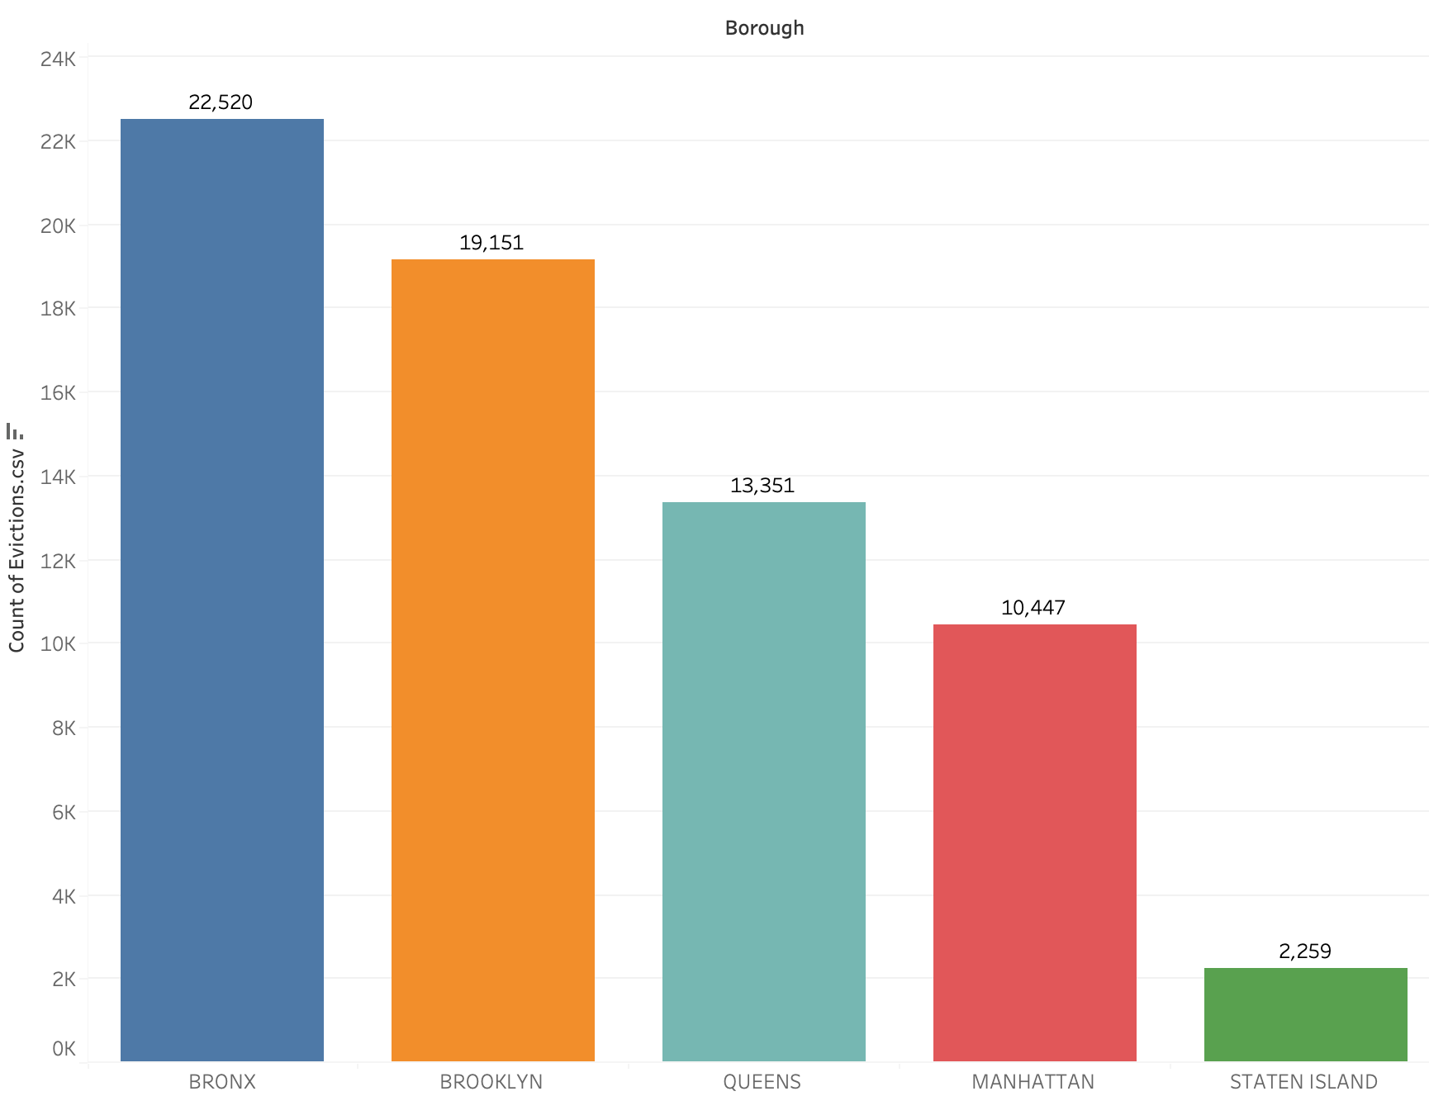
Number of Evictions in Each Borough
Highlights
Eviction data gathered from New Yorkers who completed the census in 2020
The Bronx has the most evictions at 22,520
Staten Island has the least evictions at 2,259
Notes:
Eviction data was gathered from New Yorkers who completed the census in 2020. This Bar Graph shows the number of evictions in each borough. As you can see, the Bronx has the most evictions at 22,520. Brooklyn comes in second at 19,151, Queens in third at 13,351, Manhattan in fourth at 10,447. Lastly Staten Island has the least amount of evictions at 2,259.

Slide 9
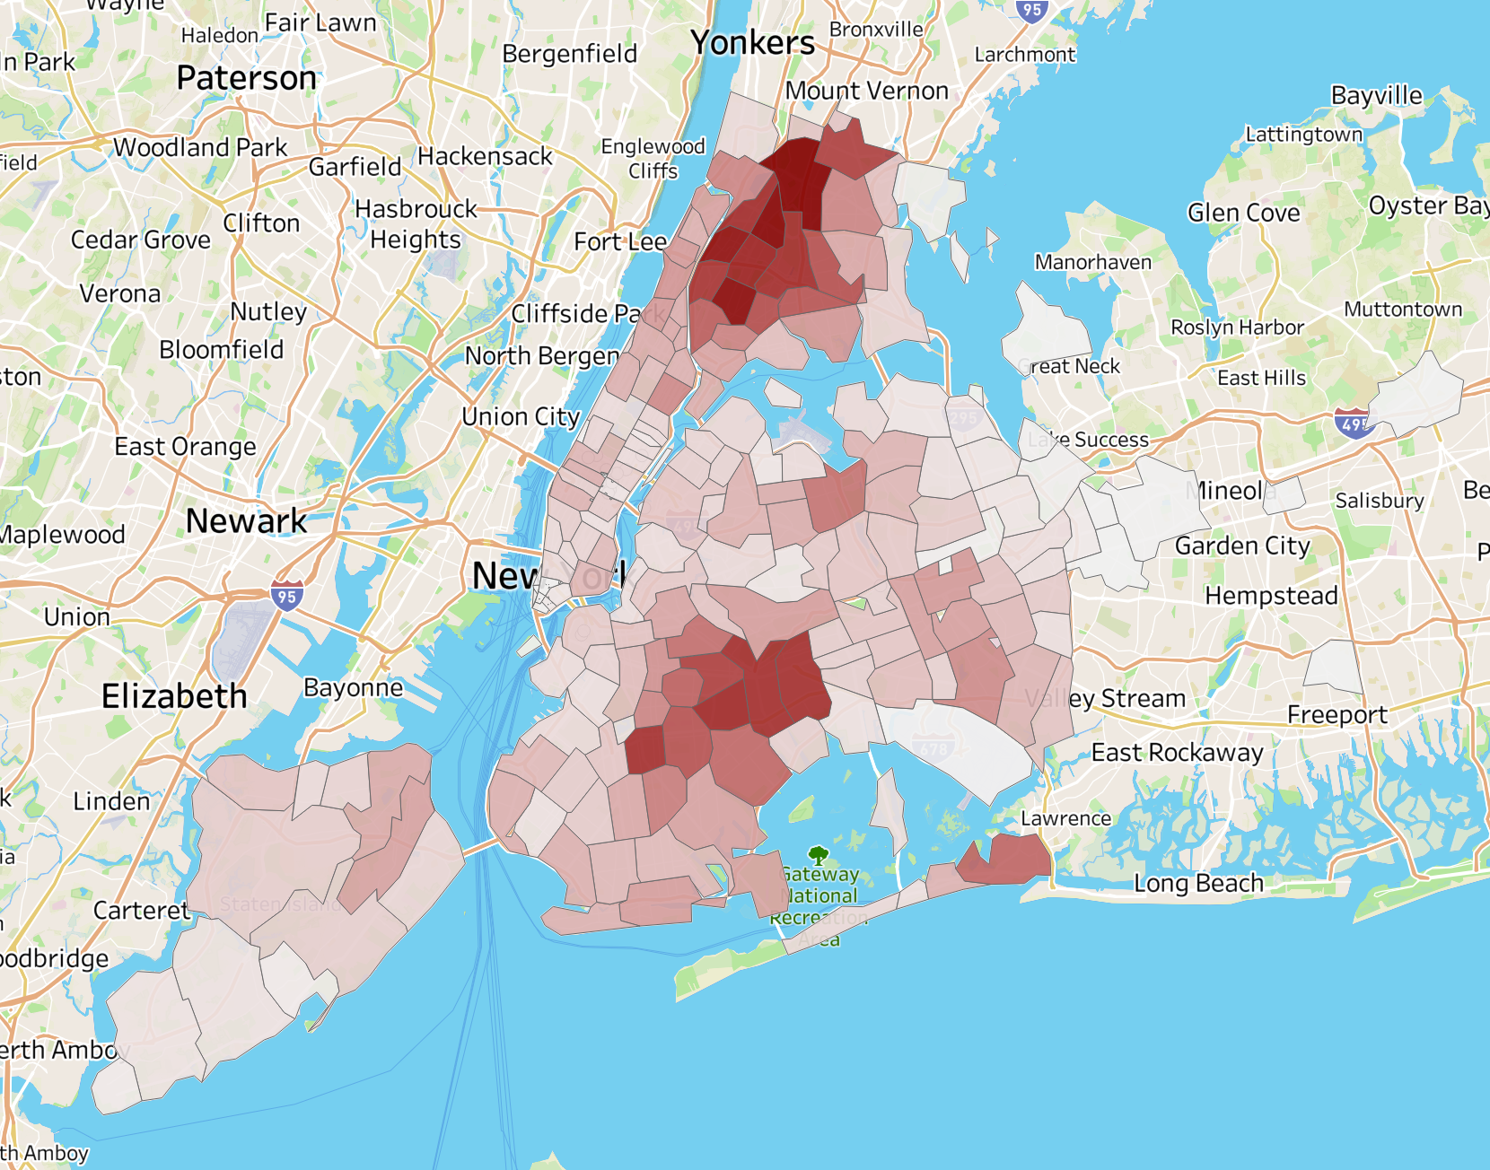
Areas with Evictions
Highlights
Evictions are concentrated
Brooklyn and Bronx have the most evictions
Staten Island has the least amount of evictions
Notes:
This Heat Map shows that evictions are concentrated. The areas with dark red coloring represent a higher amount of evictions. Areas with lighter red color and white coloring represents lower amounts of evictions. Specifically Brooklyn and the Bronx have the most evictions as proven by the dark red spots. The lightest coloring is in Staten Island which has the least amount of evictions out of all the boroughs.

Slide 10
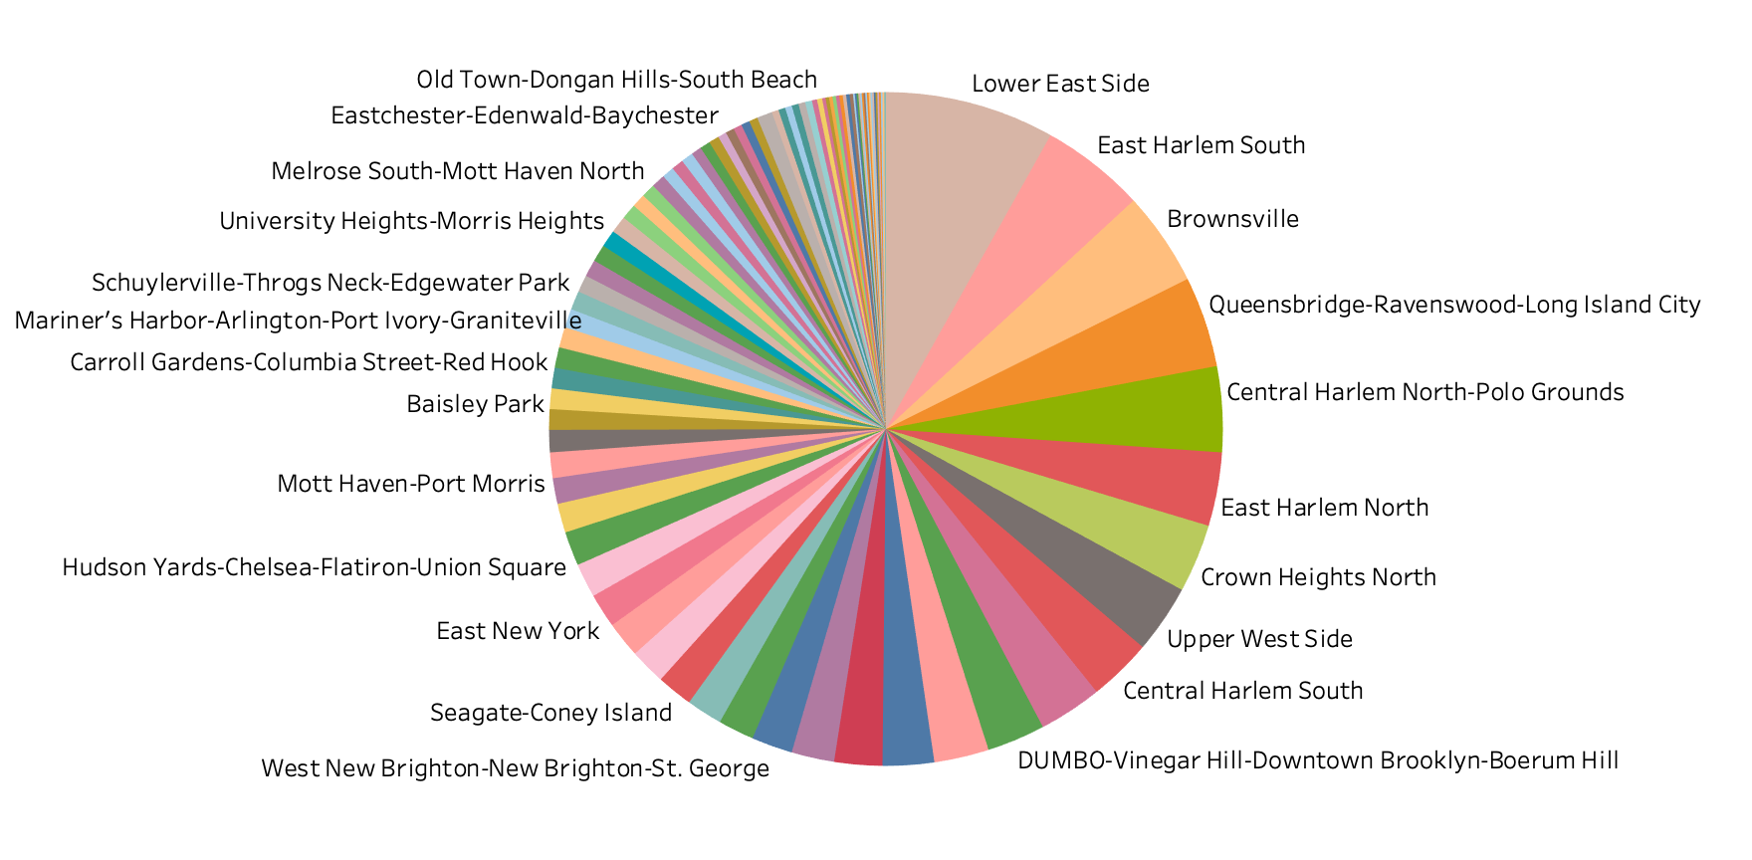
NYC Neighborhoods with Evictions
Neighborhoods with the most evictions: Lower East Side, East Harlem South, Brownsville, Queensbridge-Ravenswood-Long Island City, Central Harlem
Neighborhoods with the least evictions: Woodlawn-Wakefield, Westerleigh, West Village, Scarrett City, Springfield Gardens North
Notes:
This pie chart represent all of the NYC Neighborhoods with evictions. As you can see, the neighborhoods with the most evictions include Lower East Side, East Harlem South, Brownsville, Queensbridge-Ravenswood-Long Island City, Central Harlem.

Slide 11
Evictions vs.
Possessions
Meaningful nuance in the data set

Slide 12
Evictions
Vs.
Legal Possessions
In an eviction, the tenant's belongings are moved under the supervision of the marshal and stored at a private warehouse. This is a severe form of eviction.
Eviction means no legal right to personal property.
In a legal possession, the tenant's personal property remains under the care and control of the landlord until the tenant can arrange to transport their property to another location.
Legal Possession means the occupant has a legal right to their personal property
Notes:
https://furmancenter.org/thestoop/entry/data-update-analysis-of-renters-at-risk-as-eviction-moratorium-expires

Slide 13
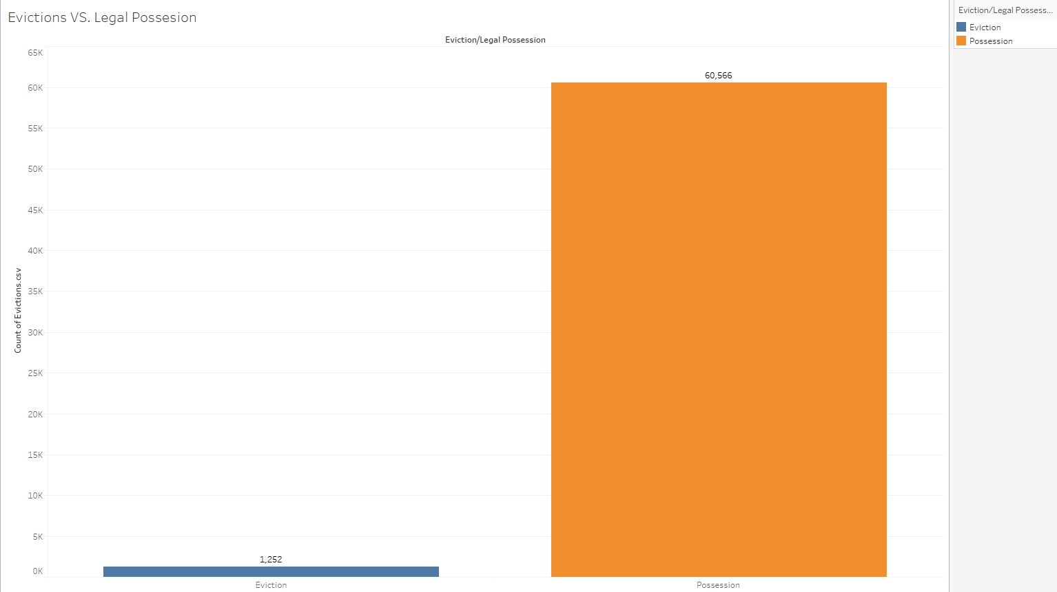
Evictions vs Possessions

Slide 14
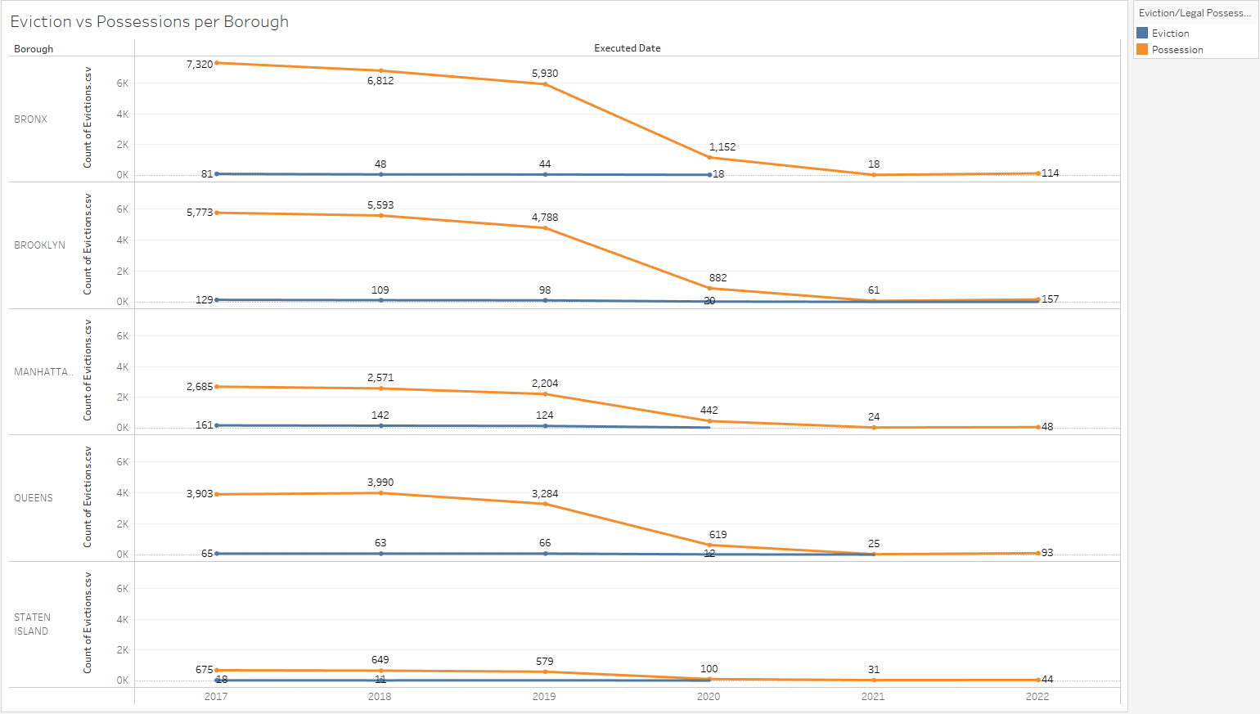

Slide 15
What does this mean for New Yorkers?
2%
Of all evictions are Evictions not Legal Possession.
Even though the number of new yorkers being evicted may seem small, still thousands go through the toughest time of their life. Being Evicted means no longer being able able to pay rent means
Tenants become occupants become squatters who are forcefully evicted and on top of that no longer have the right any of their belongings.

Slide 16
Contributing Factors
There was one major event that changed evictions rates in NYC

Slide 17
COVID-19 Pandemic
COVID-19 was a terribly tough time for a lot of people in a lot of different way ie. financially, emotionally, etc.
NYC Government knowing this, implemented The Tenant Safe Harbor Act, of 2020 allowing:
People who are not able to pay their rent because of financial hardships due to COVID-19 are protected from evictions.
Notes:
Source: https://hcr.ny.gov/covid-19-eviction-protections-tenants COVID-19

Slide 18
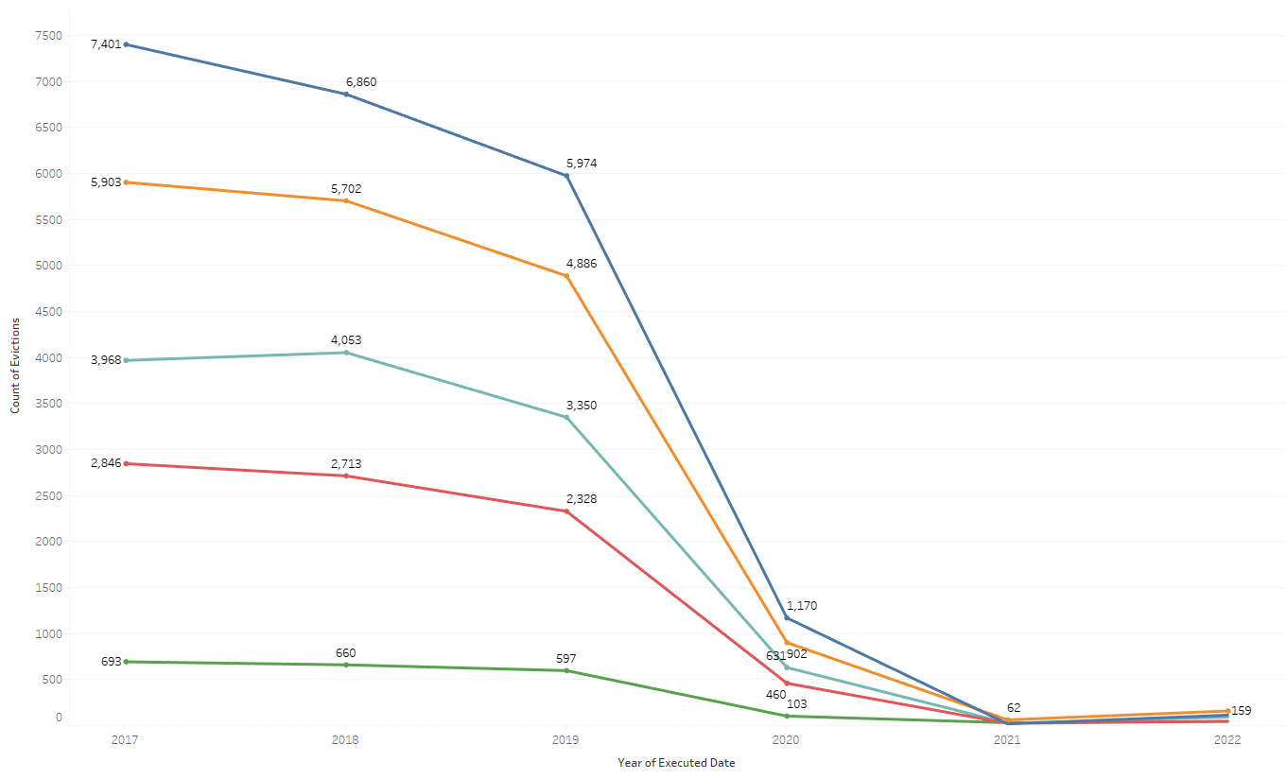
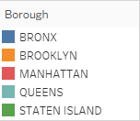
Number of Residential Eviction Cases
Evictions fall off once COVID policies are put into action.
Notes:
Here we see the exact date that covid policies were enacted and how the number of eviction cases fell.

Slide 19
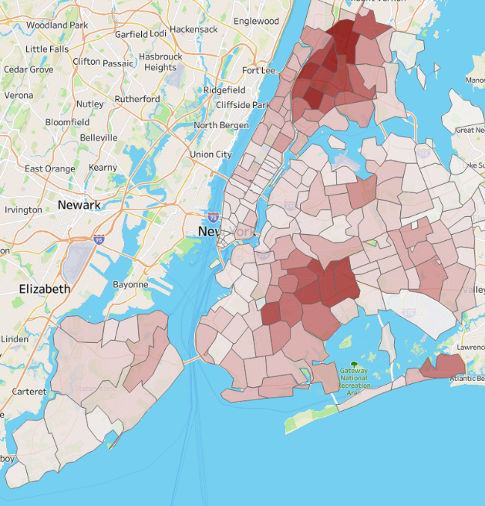
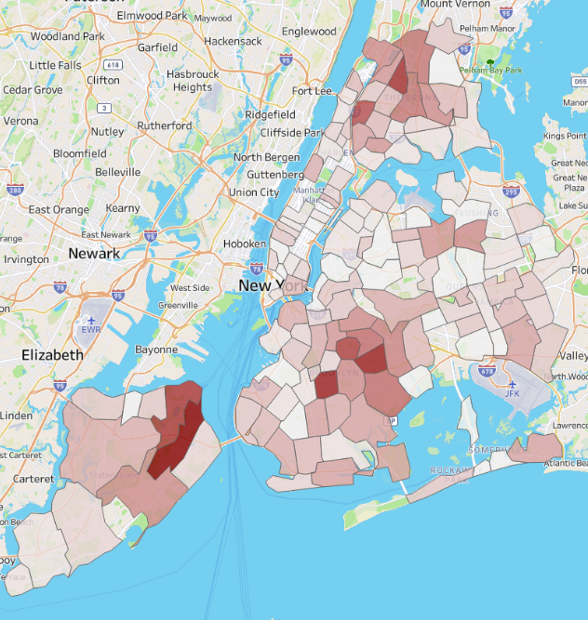
2017- Feb. 2020
March 2020 -2022
Heat Map Before and After The Tenant Safe Harbor Act.
Notes:
Jan 2017- Feb-2020 March excluded cause the policy started that month.The deeper red being about 1763 cases while the Deep Red on the right goes to 26

Slide 20
Recommended Policy Changes
The experience of the pandemic shines gleams new ideas on eviction policies.

Slide 21
The Major Life Event Policy
The most noticeable fact of this data is how much the amount of evictions drops after Covid
The Tenant Protection Act gave people at risk of losing their homes a chance to recover and keep their personal belongings as well.
These acts are temporary but there is a case to be made on we should keep them for people who are going through a major life event such as layoffs or illness.
Time to give those at risk to lose their home a way to recover.

Slide 22
Thank You
Questions?

